Slide 1
Machine Learning Foundation Online Sales Data Prediction
Name : Sachin Varshney
Cohort : August 2020
Dataset Source : Kaggle
Term : Term 3

Slide 2

Introduction
Study is to perform Machine Learning algorithm covered in ML foundation term to predict sales of online shopping.
Company Contains different types of segments - Consumer, Home office and Corporate.
Company is service provider of daily office needs .

Slide 3
Problem Statement & Scope
With the sales mentioned for online orders, we need to predict sales .
We have to use regression algorithm covered in ML foundation term.
We will use Linear Regression , Decision Tree Regressor , Random Forest Regressor Algorithm.
Scope of Study:
Only 10292 odd products and 1590 customers are included in study.
The data is from 1st,Jan 2011 to 31st Dec 2014.
Regions in scope: Africa, Oceania, EMEA, North, Central Asia, West, North Asia, Central, South, Canada, East Southeast Asia and Caribbean.

Slide 4

Libraries Used

Slide 5
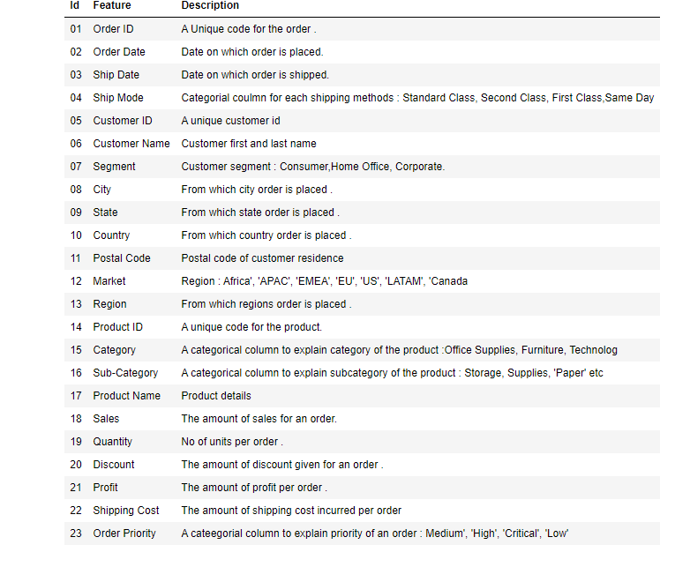
Data Description

Slide 6
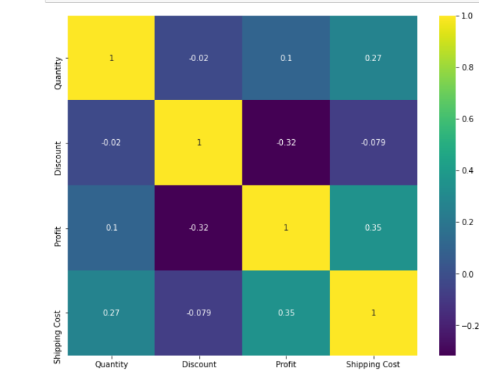
Which are correlated Independent Variables?
Correlation graph shows there is no multicollinearity between Independent Variables.

Slide 7
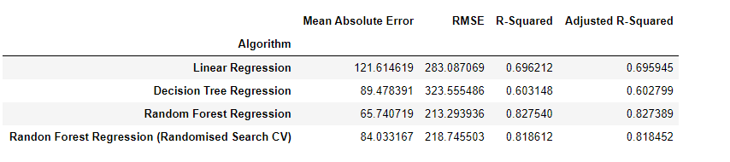
Comparison between all regression algorithm used?
Based on the Scores, looks like Radom Forest Regressor is performing well in this predicting online sales.

Slide 8
Conclusions
We can easily conclude from the scores that Random Tree Regressor is performing well in predicting online sales for UK based retailer.

Slide 9


